Slide 1
The Authentication Equation Visualizing the convergence of security and usability of text-based passwords
Cathryn Ploehn, Kristen Greene
United States National Institute of Standards and Technology

Slide 2
a universal struggle of the modern human

Slide 3
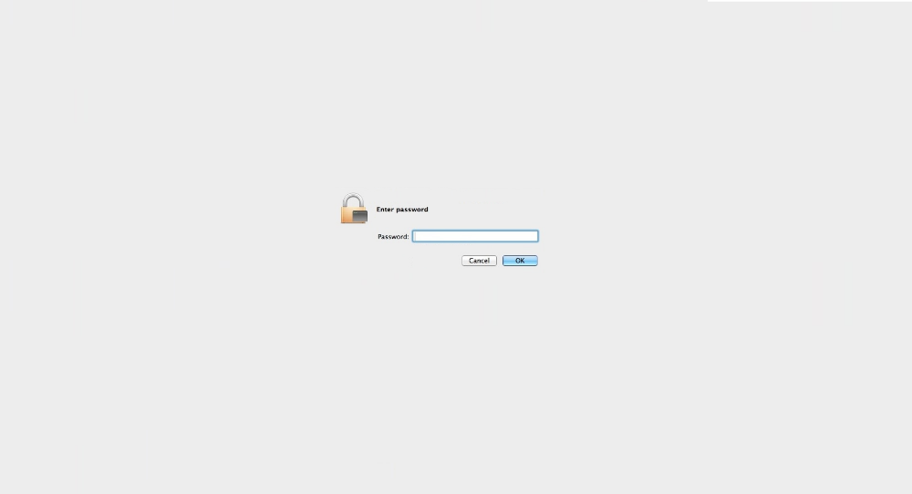
Notes:
Text based authentication

Slide 4
text-based passwords
Lacking in usability
Winning in longevity

Slide 5
text-based passwords
Super secure
super secure?
Managed by unusable (but secure) requirements

Slide 6
text-based passwords
Managed by unusable (but secure) requirements,
which cause mental strain

Slide 7
Passwords must be consistent with the following criteria:
Passwords for user accounts must have at least twelve (12) non-blank characters
Passwords must contain characters from at least three (3) of the following four (4) categories:
English upper case characters (A…Z)
English lower case characters (a…z)
Base 10 digits (0 … 9)
Non-alphanumeric characters (e.g., symbols)
Passwords must not contain common words, nouns, pronouns, acronyms, contractions, and geographic locations (i.e. dictionary words)

Slide 8
Passwords must be consistent with the following criteria:
Passwords for user accounts must have at least twelve (12) non-blank characters
Passwords must contain characters from at least three (3) of the following four (4) categories:
English upper case characters (A…Z)
English lower case characters (a…z)
Base 10 digits (0 … 9)
Non-alphanumeric characters (e.g., symbols)
Passwords must not contain common words, nouns, pronouns, acronyms, contractions, and geographic locations (i.e. dictionary words)

Slide 10
0

Slide 11
0V

Slide 12
0Vi:c

Slide 13
0Vi:cxs

Slide 14
0Vi:cxsyn0

Slide 15
0Vi:cxsyn03'An

Slide 16
0Vi:cxsyn03'An

Slide 17
Do usable and secure passwords exist?

Slide 18
Do I exist?
security
usability

Slide 19
Can we optimize password requirements for usability?
(while maintaining the security)

Slide 20
Identify which aspects of secure passwords lead to usability failures

Slide 21
Number of symbols
0Vi:cxsyn03'An
Number of digits
length

Slide 22
Explore the interaction between security and usability components of passwords

Slide 23
":MD}X,3r+v",1,3,0,1,0,0,5,65.54588851677637,"MDXrv3:},+",51.92475240350173,13.621136113274641,20.781068685625232,0,3,2,1,0,0,6,23,17,23,17,16,16,10,5,1,4
{Pfu_7P5>i,1,1,2,0,1,-1,4,65.54588851677637,PPfui75{_>,50.92475240350173,14.621136113274641,22.306717391636827,0,1,3,1,0,-1,4,22,14,22,14,15,15,10,5,2,3
"^,:Ll4~2R^",1,5,1,0,0,0,7,65.54588851677637,"LRl42^,:~^",52.661717997667935,12.884170519108435,19.656718080510498,0,5,2,1,0,0,8,22,16,19,15,16,16,10,3,2,5
3wA5~wfyRe,0,0,2,2,1,-2,3,65.54588851677637,ARwwfye35~,52.661717997667935,12.884170519108435,19.656718080510498,0,0,4,1,0,-1,4,17,14,17,14,13,13,10,7,2,1
"r};1:=Z,Nb",0,7,0,0,0,0,7,65.54588851677637,"ZNrb1};:=,",52.661717997667935,12.884170519108435,19.656718080510498,0,5,2,1,0,0,8,19,17,19,17,14,14,10,4,1,5
st<gOfZ@&8,0,3,1,1,0,-1,4,65.54588851677637,OZstgf8<@&,51.92475240350173,13.621136113274641,20.781068685625232,0,1,3,1,0,-1,4,16,15,16,15,15,15,10,6,1,3
dJ}5GRA8pj,0,0,2,2,1,-1,4,65.54588851677637,JGRAdpj58},51.92475240350173,13.621136113274641,20.781068685625232,0,0,4,1,0,-1,4,20,16,20,16,15,15,10,7,2,1
",)1i*ZNq;U",1,3,1,1,0,0,6,65.54588851677637,"ZNUiq1,)*;",51.92475240350173,13.621136113274641,20.781068685625232,0,3,2,1,0,-1,5,20,16,19,14,15,15,10,5,1,4
i&#8Zw$NS$,0,3,1,1,0,0,5,65.54588851677637,ZNSiw8&#$$,51.92475240350173,13.621136113274641,20.781068685625232,0,3,2,1,0,-1,5,20,16,20,16,17,17,10,5,1,4
h|v+wzDA3N,0,1,2,1,1,-1,4,65.54588851677637,DANhvwz3|+,51.92475240350173,13.621136113274641,20.781068685625232,0,0,3,1,0,-1,3,21,15,21,15,15,15,10,7,1,2
!0vG.bvc@h,1,1,2,1,0,0,5,65.54588851677637,Gvbvch0!.@,53.2466804983891,12.29920801838728,18.76427079821996,0,1,3,0,0,0,4,17,12,17,12,13,13,10,6,1,3
qw|43#UHbh,0,1,1,1,0,-1,2,65.54588851677637,UHqwbh43|#,51.33978990278057,14.206098613995799,21.673515967915773,0,0,3,1,0,-1,3,17,14,17,14,14,14,10,6,2,2
tw|850|_iB,0,3,1,1,0,-1,4,65.54588851677637,Btwi850||_,51.50971490422289,14.036173612553485,21.41427010934629,0,1,3,0,0,-1,3,16,13,16,13,14,14,10,4,3,3
4]I]i~L4Kn,0,3,1,0,1,0,5,65.54588851677637,ILKin44]]~,50.92475240350173,14.621136113274641,22.306717391636827,0,1,3,1,0,-1,4,24,15,24,15,14,14,10,5,2,3
!l:z3LM%8M,1,1,1,1,1,0,5,65.54588851677637,LMMlz38!:%,50.92475240350173,14.621136113274641,22.306717391636827,0,1,3,1,0,0,5,23,15,23,15,16,16,10,5,2,3
wEqC)8gdwl,0,0,2,1,0,-1,2,65.54588851677637,ECwqgdwl8),54.2466804983891,11.29920801838728,17.238622092208367,0,0,4,1,0,-1,4,14,13,14,13,13,13,10,8,1,1
?<o2$YE}jQ,1,3,0,2,0,-1,5,65.54588851677637,YEQoj2?<$},51.92475240350173,13.621136113274641,20.781068685625232,0,3,2,1,0,-1,5,21,17,21,17,17,17,10,5,1,4
m{&n3S5G2s,0,1,2,0,1,0,4,65.54588851677637,SGmns352{&,50.92475240350173,14.621136113274641,22.306717391636827,0,0,3,1,0,0,4,22,15,22,15,14,14,10,5,3,2
[35<TuIqvq,1,0,2,1,0,-1,3,65.54588851677637,TIuqvq35[<,51.33978990278057,14.206098613995799,21.673515967915773,0,0,3,1,0,-1,3,17,14,17,14,13,13,10,6,2,2
"yyY,wbDZ0@",0,0,3,2,0,-1,4,65.54588851677637,"YDZyywb0,@",51.92475240350173,13.621136113274641,20.781068685625232,0,0,3,1,0,-1,3,16,14,16,14,14,14,10,7,1,2
"1,(*sT*zWx",0,5,0,2,0,0,7,65.54588851677637,"TWszx1,(**",51.92475240350173,13.621136113274641,20.781068685625232,0,3,2,1,0,0,6,18,14,16,13,15,15,10,5,1,4
!4UH>t6L<K,1,1,2,1,1,-1,5,65.54588851677637,UHLKt46!><,51.92475240350173,13.621136113274641,20.781068685625232,0,1,3,1,0,-1,4,24,16,24,16,17,17,10,5,2,3
dLZx{s$1i:,0,1,1,1,0,0,3,65.54588851677637,LZdxsi1{$:,51.92475240350173,13.621136113274641,20.781068685625232,0,1,3,1,0,-1,4,18,15,18,15,15,15,10,6,1,3
;5NemelGX8,1,0,4,1,1,-1,6,65.54588851677637,NGXemel58;,51.92475240350173,13.621136113274641,20.781068685625232,0,0,4,1,0,-1,4,16,14,16,14,13,13,10,7,2,1
"i7#op,N2c6",0,1,1,0,1,-1,2,65.54588851677637,"Niopc726#,",51.92475240350173,13.621136113274641,20.781068685625232,0,0,3,0,0,-1,2,19,14,19,14,12,12,10,5,3,2
t-pg8ceMUs,0,0,3,1,1,-1,4,65.54588851677637,MUtpgces8-,54.2466804983891,11.29920801838728,17.238622092208367,0,0,4,1,0,-1,4,16,13,16,13,12,12,10,8,1,1
j;W7<=p*lq,0,5,0,0,0,0,5,65.54588851677637,Wjplq7;<=*,52.92475240350173,12.621136113274641,19.25541997961364,0,3,2,0,0,0,5,19,13,18,14,13,13,10,5,1,4
:r6Sa/t*|&,1,5,1,0,1,-1,7,65.54588851677637,Srat6:/*|&,53.2466804983891,12.29920801838728,18.76427079821996,0,5,2,0,0,-1,6,20,14,20,14,15,15,10,4,1,5
1$Z?=LK(Eo,0,5,0,1,0,0,6,65.54588851677637,ZLKEo1$?=(,52.92475240350173,12.621136113274641,19.25541997961364,0,3,2,1,0,-1,5,21,17,21,17,17,17,10,5,1,4
wu*QjE{u{3,0,3,1,1,0,-2,3,65.54588851677637,QEwuju3*{{,51.92475240350173,13.621136113274641,20.781068685625232,0,1,3,1,0,-1,4,21,14,20,14,15,15,10,6,1,3
0&BvcTBJua,0,0,3,1,0,-1,3,65.54588851677637,BTBJvcua0&,52.92475240350173,12.621136113274641,19.25541997961364,0,0,4,1,0,0,5,16,15,16,15,15,15,10,8,1,1
%@5B{0bNHL,1,1,2,1,0,0,5,65.54588851677637,BNHLb50%@{,51.92475240350173,13.621136113274641,20.781068685625232,0,1,3,1,0,0,5,22,18,22,18,17,17,10,5,2,3
oPML~G}O8g,0,1,1,1,1,-1,3,65.54588851677637,PMLGOog8~},52.661717997667935,12.884170519108435,19.656718080510498,0,0,3,1,0,-1,3,23,17,23,17,17,17,10,7,1,2
"7o{,%~hM6D",0,5,1,1,1,-1,7,65.54588851677637,"MDoh76{,%~",51.33978990278057,14.206098613995799,21.673515967915773,0,3,2,1,0,-1,5,21,16,21,16,15,15,10,4,2,4
^d)6JgD:N8,1,1,1,1,0,0,4,65.54588851677637,JDNdg68^):,50.92475240350173,14.621136113274641,22.306717391636827,0,1,3,1,0,0,5,21,16,20,14,16,16,10,5,2,3
b5SAY8V7n$,0,0,4,1,1,-1,5,65.54588851677637,SAYVbn587$,51.92475240350173,13.621136113274641,20.781068685625232,0,0,4,1,0,-1,4,21,15,21,15,15,15,10,6,3,1
j;LqL8GHN8,0,0,3,1,1,0,5,65.54588851677637,LLGHNjq88;,52.661717997667935,12.884170519108435,19.656718080510498,0,0,4,1,0,0,5,20,16,20,16,15,15,10,7,2,1
&G};a+5.}Z,1,7,0,0,0,0,8,65.54588851677637,GZa5&};+.},54.2466804983891,11.29920801838728,17.238622092208367,0,7,1,1,0,-1,8,23,18,23,18,16,16,10,3,1,6
^S9ha|[c&a,1,3,1,0,1,-1,5,65.54588851677637,Shaca9^|[&,52.92475240350173,12.621136113274641,19.25541997961364,0,3,2,0,0,-1,4,21,14,20,14,14,14,10,5,1,4
8Y*sAm>H[l,0,3,1,1,0,-1,4,65.54588851677637,YAHsml8*>[,51.50971490422289,14.036173612553485,21.41427010934629,0,1,3,1,0,-1,4,24,15,23,15,15,15,10,6,1,3
gN2b[7K(Al,0,1,1,1,1,-1,3,65.54588851677637,NKAgbl27[(,50.92475240350173,14.621136113274641,22.306717391636827,0,0,3,1,0,-1,3,21,16,21,16,14,14,10,6,2,2
}GdB.J/2pJ,1,1,2,2,0,0,6,65.54588851677637,GBJJdp2}./,51.92475240350173,13.621136113274641,20.781068685625232,0,1,3,1,0,0,5,21,17,21,17,15,15,10,6,1,3
somehow.

Slide 25
visualization tool to explore usability and security password metrics

Slide 26
Goals of the tool
support password usability research activities
integrate various measurements of passwords
leverage web technology

Slide 27
Goals of the tool
flexibly display data
enable the exploration of where password security and usability collide
share with research community as an open source tool

Slide 28
Tool composition
Password metric computation
Python3 code, run from terminal
Password metric visualization
Browser, D3.js

Slide 29
1
usability
and security metrics

Slide 30
task: automate computation of password metrics

Slide 31
metrics
Linguistic and phonological difficulty
Entropy
number of keystrokes
password permutation

Slide 32
Entropy
Uncertainty in a random variable, commonly used to measure theoretical password strength
**Line used as an example – does not reflect real data

Slide 33
Entropy
security
(password strength)
Uncertainty in a random variable, commonly used to measure theoretical password strength
Has limitations
bits of entropy
(uncertainty, randomness)
**Line used as an example – does not reflect real data

Slide 34
Linguistic and Phonological Difficulty
Similarity of password to natural language.

Slide 35
How pronounceable is a password?

Slide 36
Number of keystrokes
Number of keystrokes to enter a password in desktop, android, and iOS devices.

Slide 37
Password permutation
Rearrange passwords by character type to decrease keystrokes needed to enter on mobile devices

Slide 38
Outcome: code to produce metrics for a list of passwords

Slide 39
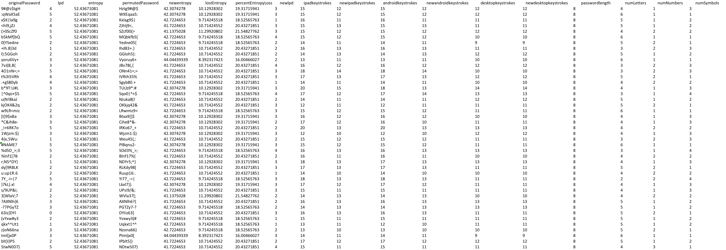
output

Slide 40
How can we view and interact with the data?

Slide 41
2
Building a password
visualization tool

Slide 43
Design goals
Scalability
Tiers of granularity
Side by side comparison
Interactivity

Slide 44
visualization in the browser
Available, flexible, interactive

Slide 45
visualization in the browser
HTML, CSS, JavaScript

Slide 46
D3.js

Slide 47
Heatmap
higher value
lower value

Slide 48
Heatmap
Original password metrics
Permuted password metrics

Slide 49
Heatmap
Original password metrics
Permuted password metrics
New desktop keystrokes
New Android keystrokes
Desktop keystrokes
Android keystrokes
New iOS keystrokes
iOS keystrokes
New entropy
entropy
New LPD
LPD

Slide 50
Scalability
Works for 10, 100, 1000 passwords

Slide 51
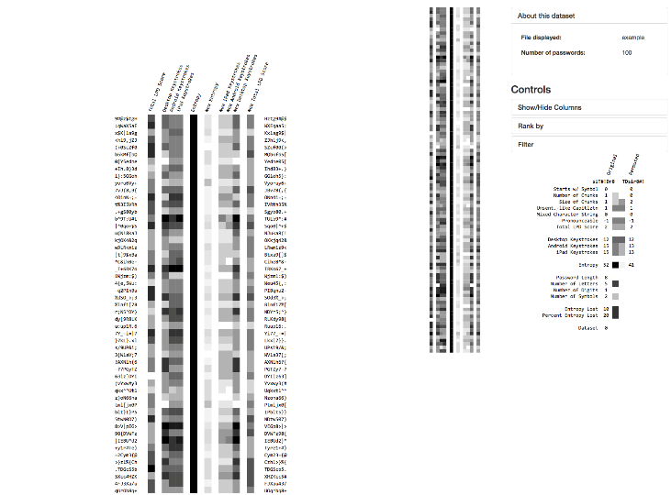
Tiers of granularity
Overview first, then details on demand

Slide 52
Tiers of granularity
Overview first, then details on demand

Slide 53
Tiers of granularity
Overview first, then details on demand

Slide 54
Tiers of granularity
Overview first, then details on demand

Slide 55
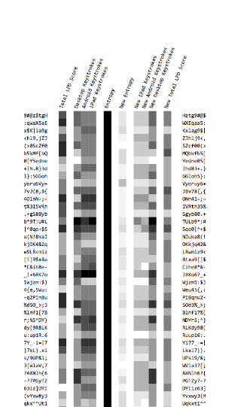
Side by side comparison
Compare passwords with their
permuted counterparts

Slide 56
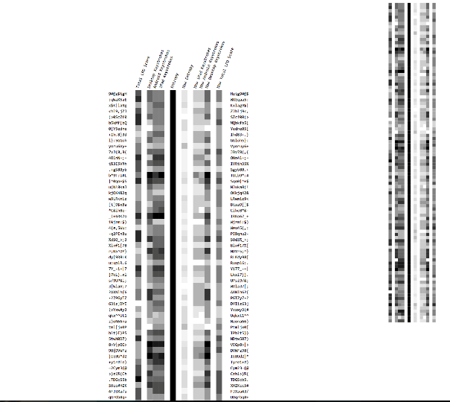
Interactivity
Filter, sort, etc.

Slide 57
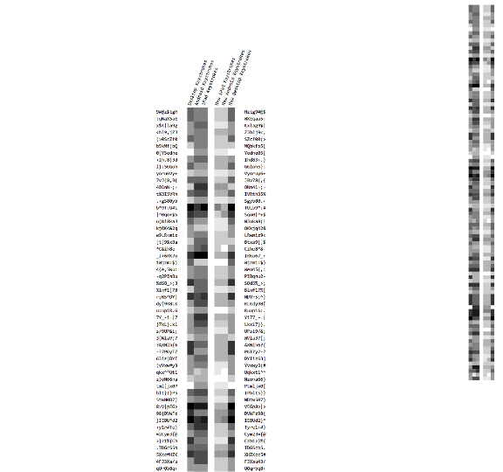
Interactivity
Hide columns

Slide 58
Interactivity
Hide columns

Slide 59
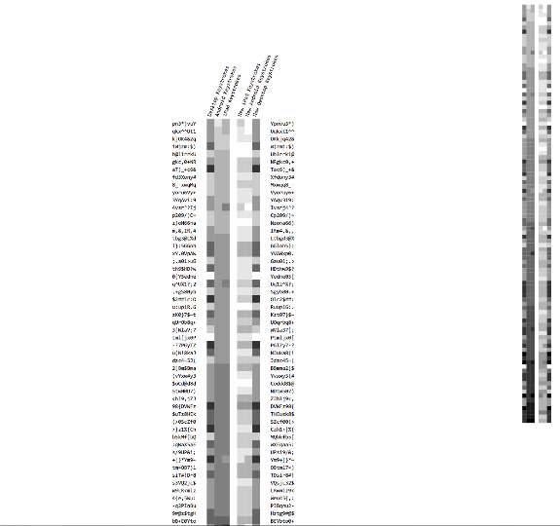
Interactivity
Sort rows

Slide 60
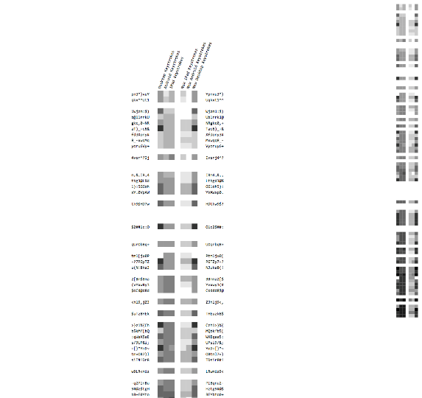
Interactivity
Filter rows

Slide 61
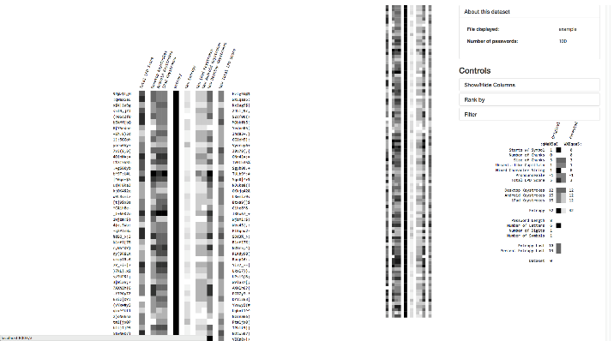

Slide 62
Limitations
Number of passwords viewable low
Upload bottleneck
Relationships hard to view
Can’t compare multiple datasets

Slide 63
Limitations
Code organization
Usability
Requires hard coding
GUI could do more

Slide 64
Tool improvements
More visualization paradigms
Added parallel coordinates. Can view more precisely the interactions between datasets
Compare multiple datasets
GUI improvements
upload files
Restructuring code
encapsulation/modularization
Flexibility
reusability

Slide 65
Parallel coordinates
Common way of analyzing multivariate data

Slide 66
Parallel coordinates
Increase the number of passwords capable of being rendered

Slide 67
Parallel coordinates
Makes relationships between variables more apparent

Slide 68
< canvas >
Render larger datasets by queuing data to be rendered

Slide 69
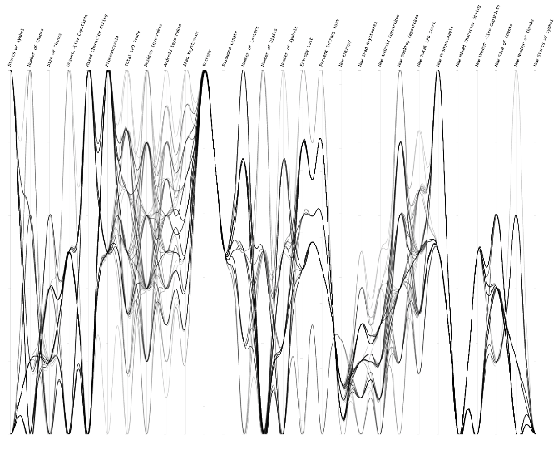
Scalability
Works for 10, 100, 1000 passwords

Slide 70
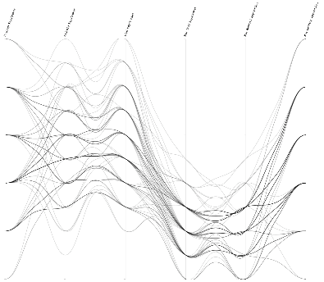
Side by side comparison
Compare passwords with their permuted counterparts

Slide 71
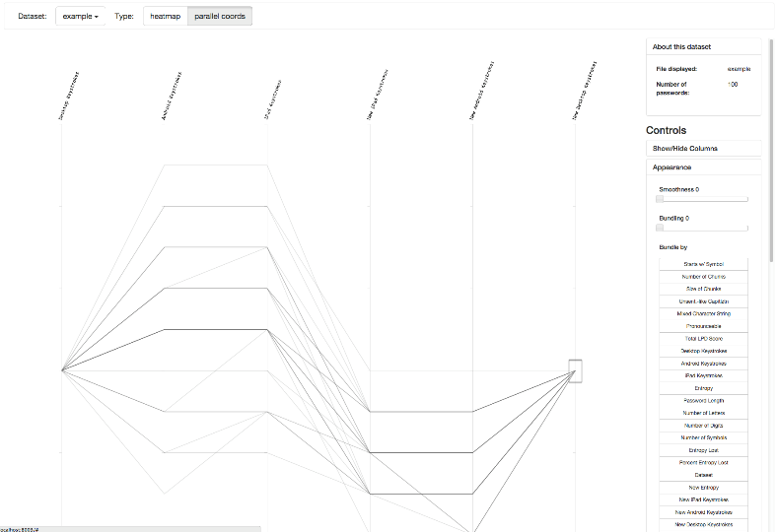
Interactivity
Filter, sort, etc.

Slide 72
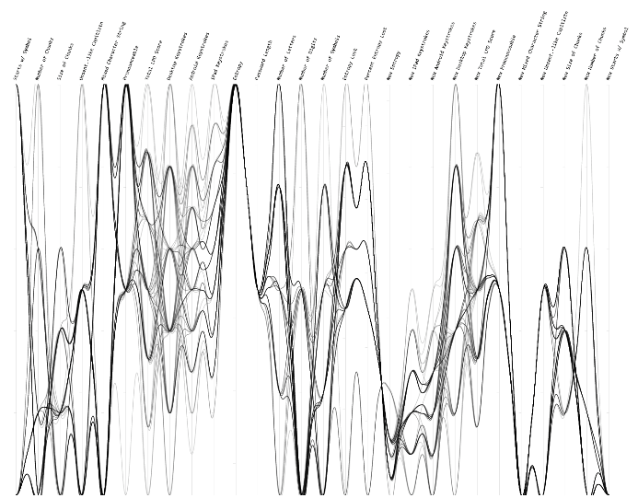
Hide columns

Slide 73
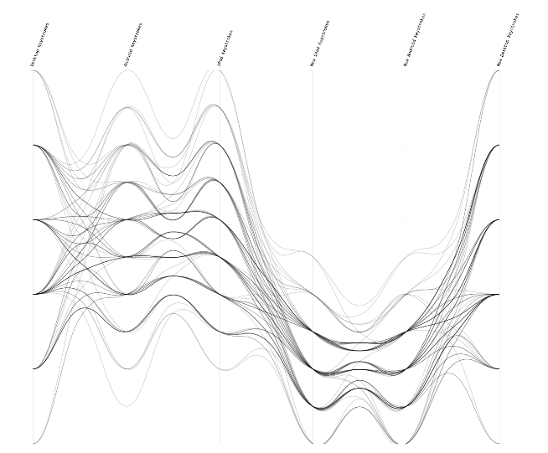
Hide columns

Slide 74
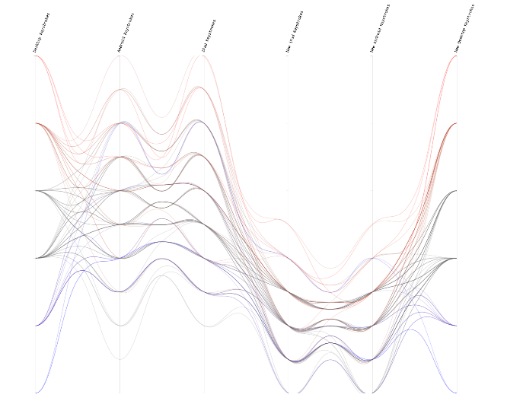
Change line coloring

Slide 75
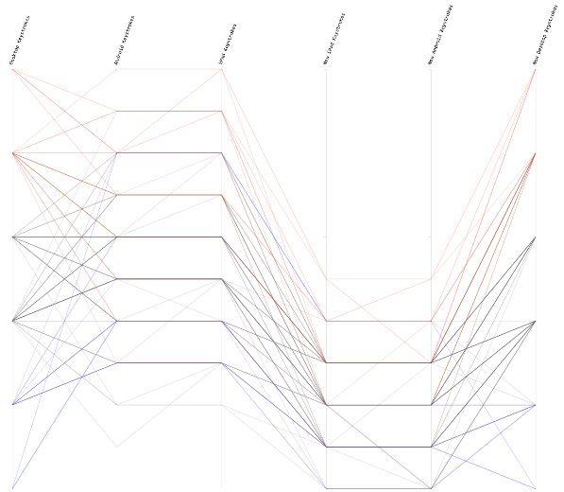
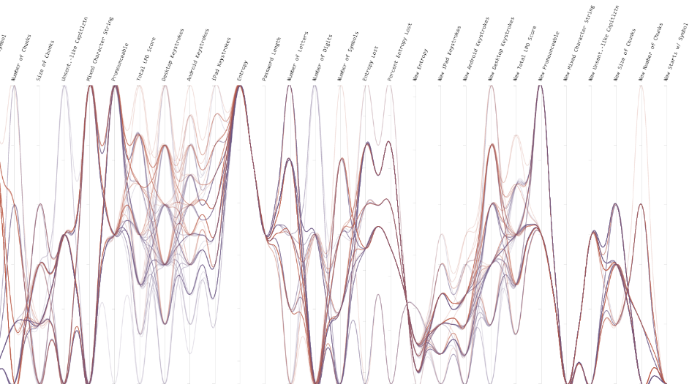
Change line
bundling & smoothness

Slide 76
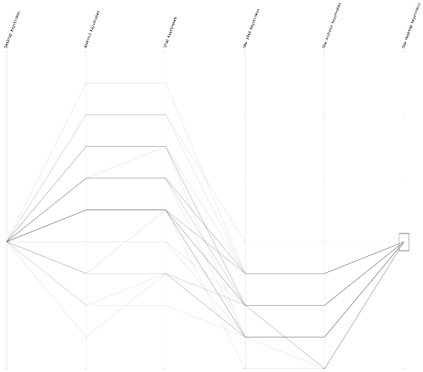
Brushing

Slide 77
Compare datasets

Slide 78
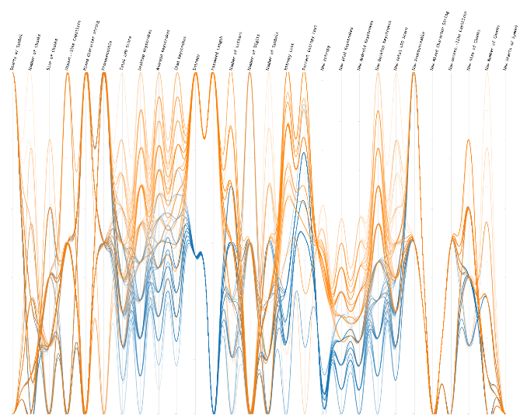

Slide 79
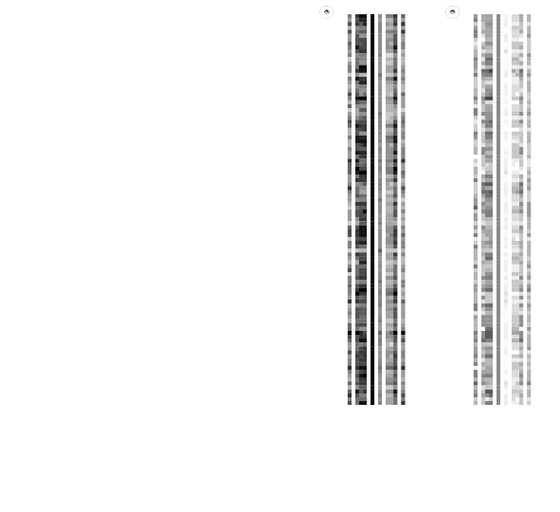

Slide 80
GUI improvements

Slide 81
GUI improvements

Slide 82
Code restructuring
Modular design

Slide 83
3
Walkthrough

Slide 84
4
Lessons
learned

Slide 85
Understand and communicate the encoding scheme of visualization

Slide 87
Understand constraints of specialized visualization tools

Slide 88
Future work
Compare the LPD score with usability data
Expansion of security metrics / accurate description of password strength
Expand into a generic multivariate data analysis tool
Client side calculation of password values

Slide 89
Questions?
github.com/usnistgov/DataVis

